Slide 1

Internal Quality Assurance Cell
Bethune College
2017-2023

Slide 2
Constitution of IQAC
In pursuance of the NAAC Peer Team's recommendation for performance evaluation, assessment and accreditation and quality up-gradation, the Internal Quality Assurance Cell (IQAC) of Bethune College was established on 29th November, 2006 as a post-accreditation quality sustenance measure.
IQAC was regularly re-constituted from time to time as per UGC guidelines .
The present IQAC was reconstituted on 6th September, 2022 and confirmed on 19th October, 2022.

Slide 3
Composition of IQAC
External Members: 8
Prof. Puspa Misra - Former Principal, Bethune College & Alumna, Advisor
Prof. Pratip K. Chaudhuri - Former DPI and Management educationist, Advisor
Prof. Krishna Roy- Former Principal, Bethune College & Academician, Advisor
Dr. Ramaprasad Bhattacharya - Jt. DPI (Sr. Administrative Officer)
Prof. Sampa Chakrabarti - Department of Chemical Engineering (CU), Alumna
Shri Aveek Majumder- Chairman, Expert committee on School Education, Member from local society
Prof (Dr.) Subir Dasgupta - Department of Zoology, Maulana Azad College, Sr. Administrative member
Shri. Indranil Roy- Parent Representative
Internal Members: 12
Dr. Anushila Hazra Bhattacharya: Officer-in-charge – Chairperson
Dr. Sudeshna Mitra: Department of Philosophy - IQAC Coordinator
Dr. Kamal Kanti Som: Department of Physics
Dr. Nilanjana Bagchi: Department of Psychology, Teachers' Council Secretary
Dr. Amita Kar: Department of Chemistry
Dr Dipayan Chattopadhyay: Department of Botany
Dr. Gautam Goswami: Department of Physics
Dr. Satarupa Bandyopadhyay: Department of Economics
Shri Sumanta Mukhopadhyay: Department of Bengali
Dr. Piyali Gupta: Department of English
Smt Anjali Maisal: Librarian
Smt. Ananya Misra: Student representative

Slide 4
IQAC Meetings
Academic Session (1st June – 31st May) | Total No. of Meetings | Meeting Dates
2017-18 | 3 | 23.11.2017, 8.12.2017, 25.4.2018
2018-19 | 5 | 7.8.2018, 2.1.2019, 6.3.2019, 9.4.2019, 21.5.2019
2019-20 | 6 | 9.7.2019, 19.9.2019, 27.9.2019, 18.12.2019, 8.1.2020, 20.3.2020
2020-21 | 6 | 24.7.2020, 16.8.2020, 12.9.2020, 9.2.2021, 8.4.2021, 13.4.2021
2021-22 | 6 | 2.6.2021, 12.8.2021, 14.9.2021, 7.10.2021, 15.3.2022, 13.5.2022
2022-23 | 8 | 2.8.2022, 6.9.2022, 27.9.2022, 11.10.22, 19.10.22, 28.10.22, 21.2.23, 6.3.23

Slide 5
Functions & Activities of IQAC

Slide 6
Overall Activities
ACADEMIC CALENDER
FEEDBACK FROM STAKE
HOLDERS
CAREER ADVANCEMENT SCHEME (CAS)
SUPPORT SYSTEM TO STUDENTS
ANNUAL QUALITY ASSESSMENT REPORT (AQAR)
IQAC
ACADEMIC AUDIT
ASSISTING FACULTY MEMBERS TO ATTAIN HIGHER STANDARDS IN TEACHING- LEARNING
COLLABORATIVE ACTIVITIES
NIRF
AISHE

Slide 7
IQAC INITIATIVES
2017 - 2023
External and Internal Academic audit
Submission of AISHE data regularly
Submission of AQAR regularly
Participation in NIRF
Feedback from Stakeholders , its analysis and Action taken report
Students’ Satisfaction Survey
Holding regular meetings for Quality Improvement
Career Advancement of Teachers (CAS)
The IQAC promotes all academic and cocurricular activities in the college like Seminars, Workshops, Training Program, Faculty Development program, Memorial lectures, Invited lectures, departmental seminars, academic trips, outreach initiative etc. for knowledge dissemination and quality enhancement throughout the academic session.
Making Policy documents like E-governance policy document, Grievance redressal Policy Document, Annual Gender Sensitisation Action Plan, Divyangjan Policy, Code of Conduct, Green Initiatives

Slide 8
Some of the significant initiatives by IQAC 2017 - 2023
2017 - 18
IQAC organized a one day interactive seminar (dated: 4th May, 2018) on CBCS curriculum to be implemented from next academic session.
In order to strengthen the feedback system, feedback on Individual Teachers by Students was added to General feedback.
Provision for RTI and transcripts for students applying abroad after post graduation have been introduced from this session
Orientation Programme for Freshers at the beginning of Academic Year 12-Jul-2017
2018 - 19
IQAC took initiative to participate in NIRF rankings for the first time and Bethune College ranked 50th in the College category.
For appropriate implementation of the CBCS curriculum, the IQAC continuously monitored the academic activities throughout the year.
Observance of “Sampriti Saptaha” to commemorate the 125th Anniversary of Chicago Address delivered by Swami Vivekananda in collaboration with RKM Swami Vivekananda’s Ancestral Home and Cultural Centre

Slide 9
Some of the significant initiatives by IQAC 2017 - 2023
2019 - 20
IQAC was proactive in applying for DBT Star College and five departments received financial support under the DBT Star College Scheme of the Department of Biotechnology, Ministry of Science and Technology, Government of India in 2020.
In order to combat the Pandemic situation, IQAC took steps to continue online Teaching Learning, mentoring, counselling during the Lockdown period and thereafter. Special Webinars on Pandemic awareness and other miscellaneous topics were organized.
IQAC took initiative to participate in NIRF rankings for the second time ranking 88th in the College category. The College also participated in Education World India Rankings India Today College Rankings (3rd Rank in Kolkata).
Preparation of NAAC 3rd cycle.
Tuesday Lecture series was initiated by IQAC for intellectual stimulation and interdisciplinary interaction of faculty members.
Student mentoring system was formalized.

Slide 10
Some of the significant contributions by IQAC 2017 – 2023 (Contd.)
2020 – 21
Bethune College has acquired 77th position in the College Category in NIRF ranking (2021). It is the only Government College from West Bengal to feature among the first hundred colleges in the country.
2 Certificate courses for students with duration of 30 hours or more were initiated. Ethics and Value Education Certificate course was successfully completed. The course on Bratachari - the famous cultural heritage of West Bengal, was started with an introductory workshop and is continuing.
Lockdown initiatives: As the pandemic situation continued, IQAC took steps to maintain the standard of teaching learning in digital mode. Workshops and short term courses were organized on Online teaching. Exams were conducted and scripts checked, in Online mode, under the supervision of IQAC. Records of Online classes were kept in detail.
2021 – 22
Submission of AQAR 2020-21, 2019-20.
Student Exchange/ Faculty Exchange Programme with other institutions were organized.
Students’ Satisfaction Survey was conducted for the first time in July 2021.
Bethune College secured 74th rank in NIRF ranking 2022 under college category.

Slide 11
Some of the significant contributions by IQAC 2017 – 2023 (Contd.)
2022 – 23 (Till date)
External Academic and Administrative Audit on 29th July, 2022.
IIQA-SSR UPLOAD and initiation of 3rd Cycle NAAC Accreditation.
Internal Academic Audit.
IQAC organized a seminar on National Education Policy (NEP) for College teachers on 23rd February, 2023.
Visit by Mentoring team on upcoming NAAC on 3rd March 2023.

Slide 12
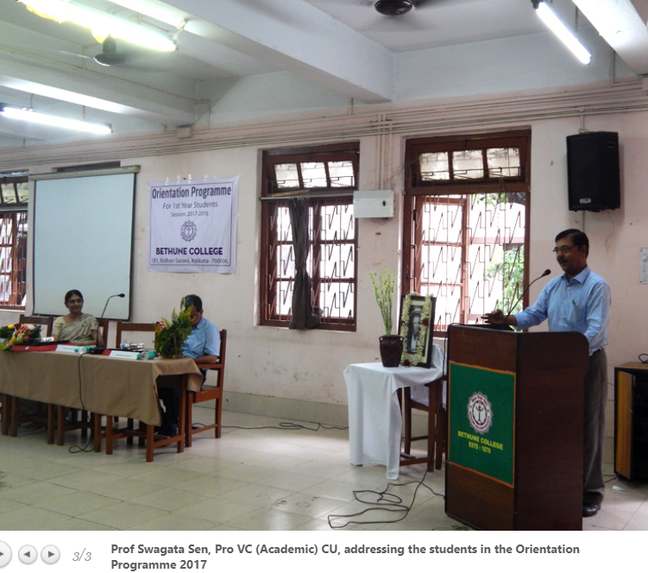
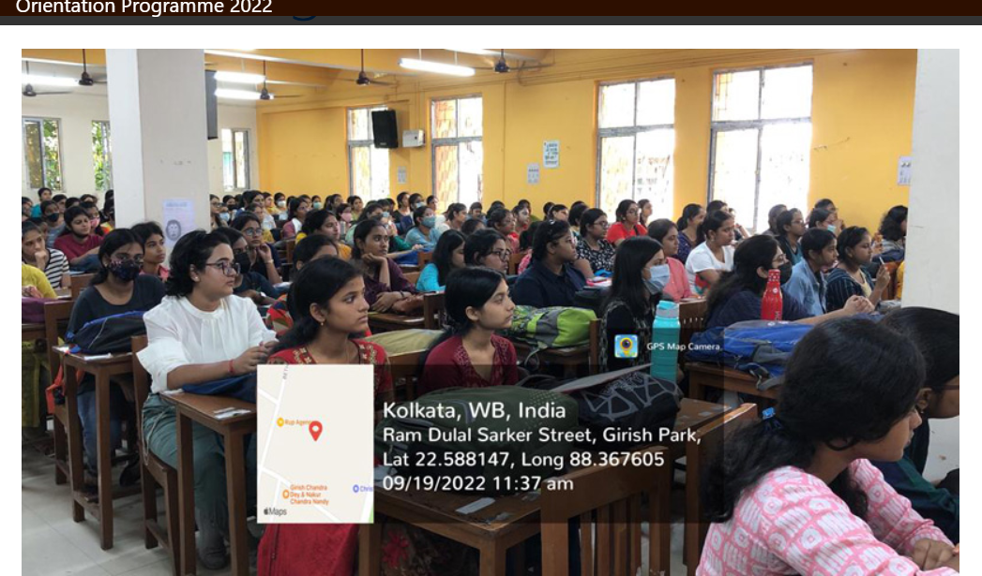
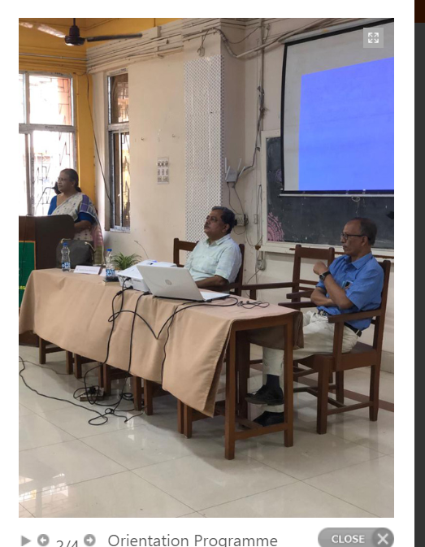
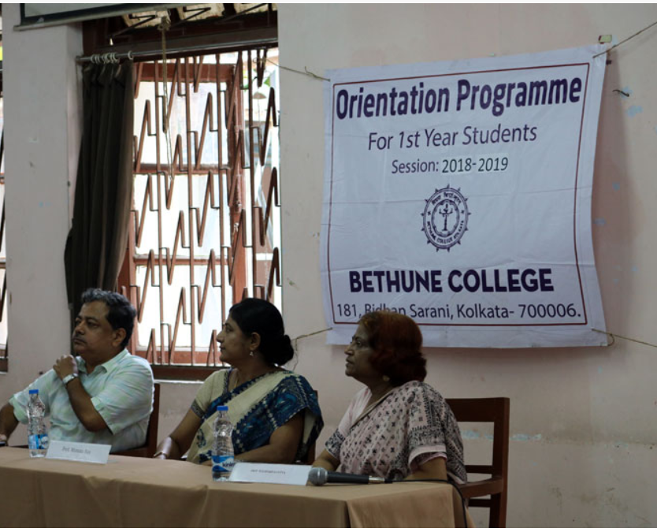
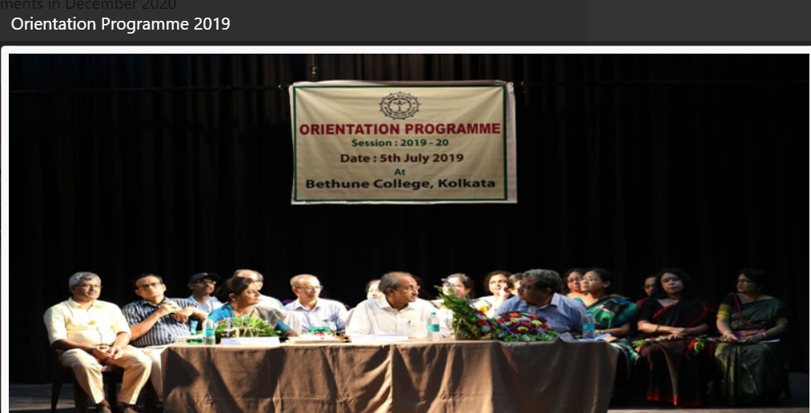
Organising Orientation Programme for Freshers every session

Slide 13

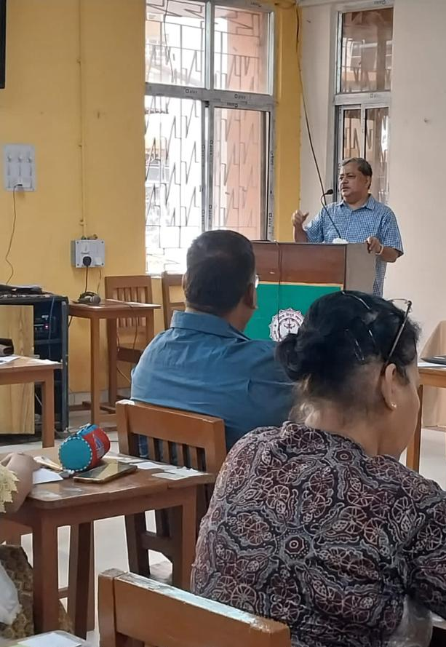
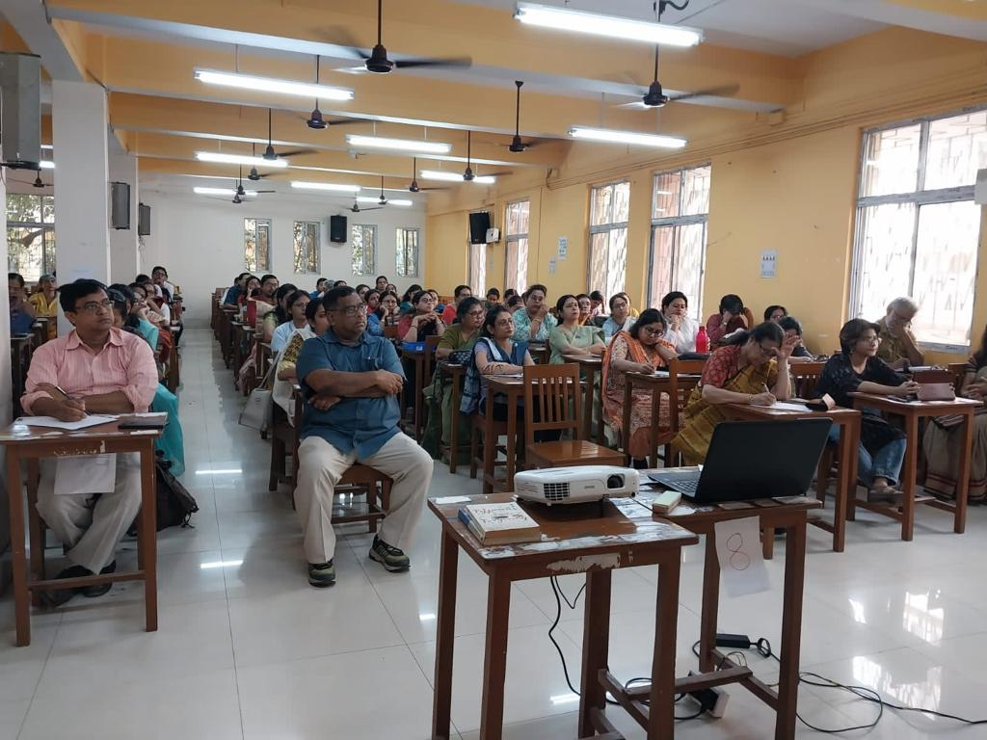
Seminars
Seminar on National Education Policy (NEP) for College teachers, 2023
Speaker : Sri Debashish Biswas, Inspector of Colleges, University of Calcutta

Slide 14


State Level Seminar on Celebration of 200th Birth Anniversary of Pandit Ishwar Chandra Vidyasagar - Revisiting the Renaissance Man was organized by IQAC with the departments of Philosophy, History, Sanskrit, Hindi and Bengali on 11th February, 2020

Slide 15


2 State-level Seminar on Career Counselling and Soft Skill Development and on Soft Skills ; The Department of English along with Depts of Mathematics, Economics, Computer Science and Statistics in collaboration with IQAC, Bethune College
19th February, 2020
Seminar Proceedings

Slide 16
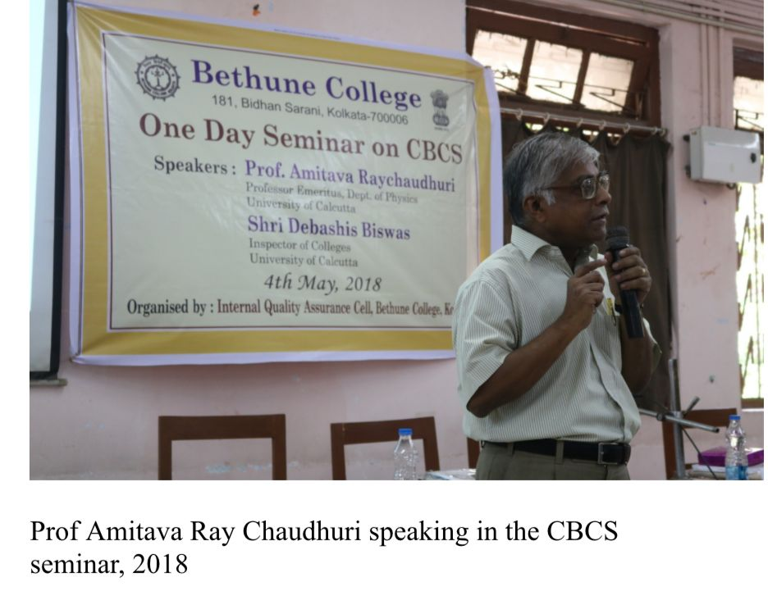
Seminars
Seminar on CBCS, 2018
Speakers :
Prof. Amitava Raychaudhuri, Professor Emeritus, Dept. of Physics, University of Calcutta
Sri Debashish Biswas, Inspector of Colleges, University of Calcutta

Slide 17
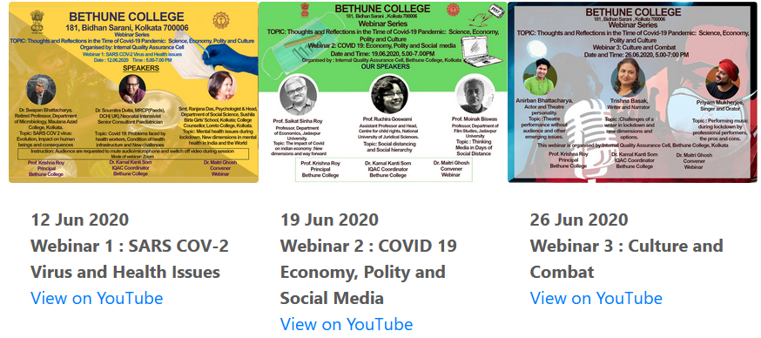
Webinars
Webinar series on 'Thoughts and Reflections in the Time of Covid-19 Pandemic : Science, Economy, Polity and Culture" organized by IQAC, Bethune College

Slide 18
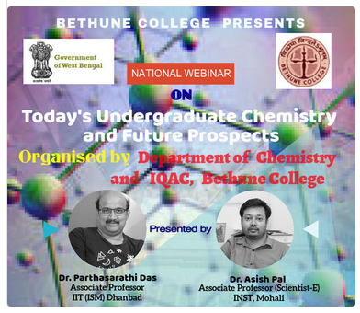
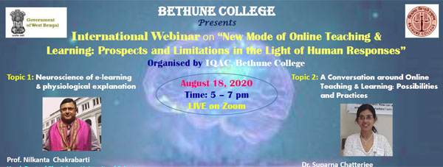
Webinars
National Webinar on Today's Undergraduate Chemistry and Future Prospects, Organized by the Department of Chemistry and IQAC, Bethune College, 2020
International Webinar on New Mode of Online Teaching & Learning: Prospects and Limitations in the Light of Human Responses , Organized By: IQAC, Bethune College, Kolkata

Slide 19
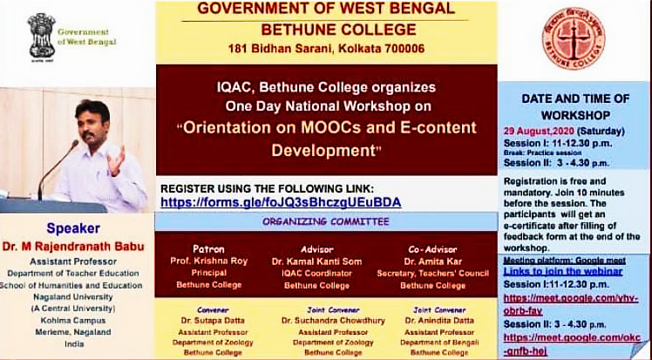
Workshops
National Workshop on “Orientation on MOOCs and E-content Development, Organized by IQAC, Bethune College, 2020

Slide 20
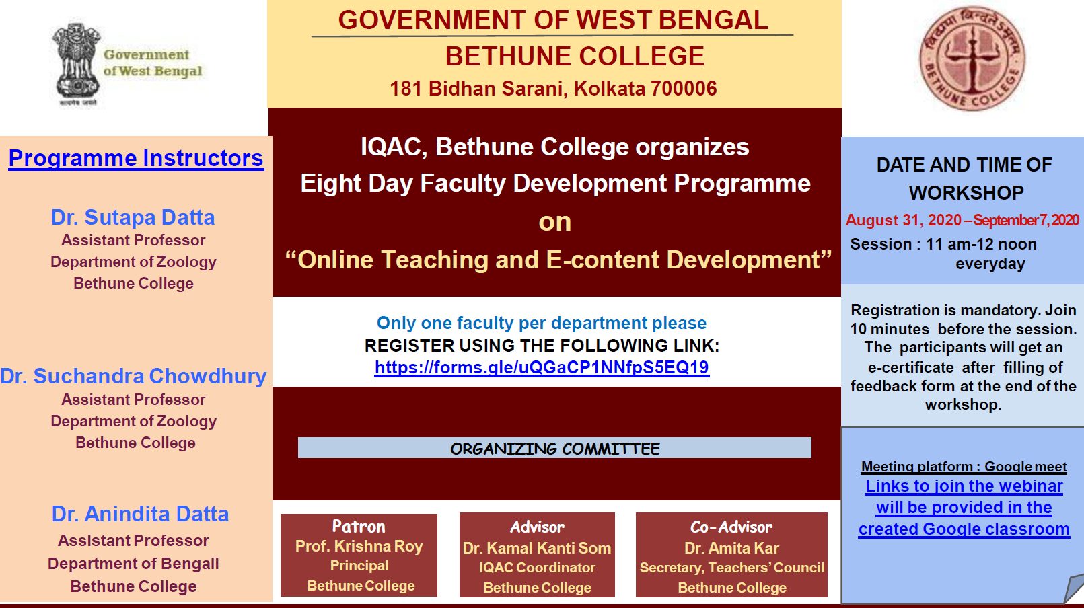
Faculty Development Programme
8 Day FDP on “Online Teaching and E-content Development”, Organized by IQAC, Bethune College, 2020

Slide 21
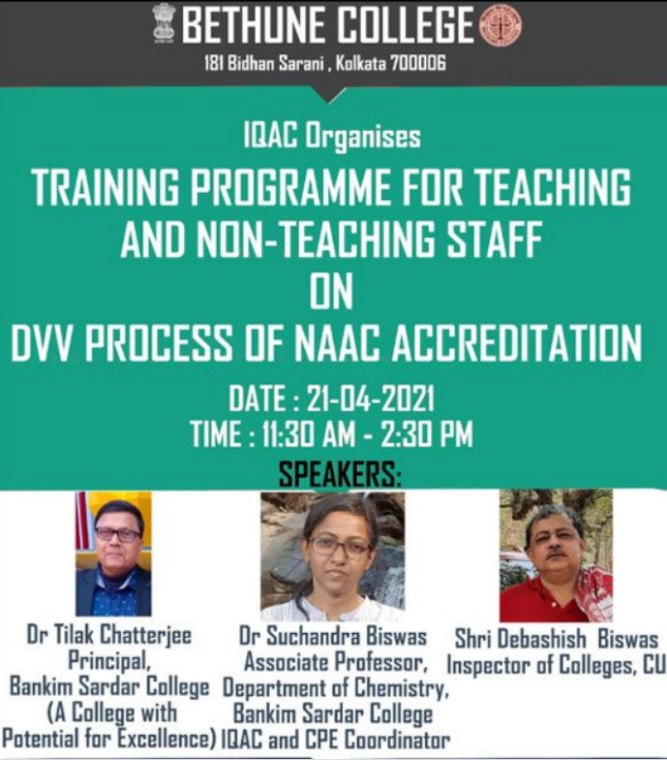
Training Programme for Teaching and Non-teaching Staff on DVV

Slide 22
No. of Seminars/ Webinars/conferences/workshops conducted by the College

Slide 23
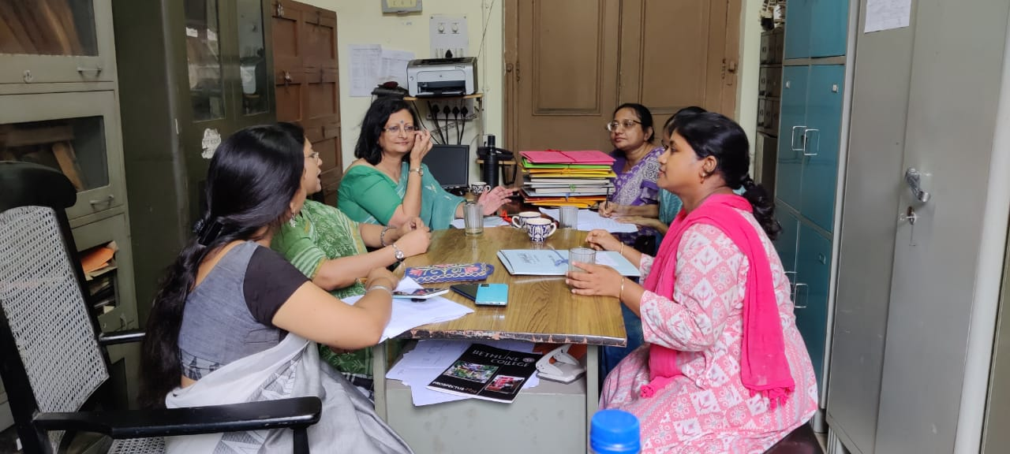
Academic Audit
Internal Audit at Sanskrit Department on 8th July, 2022

Slide 24
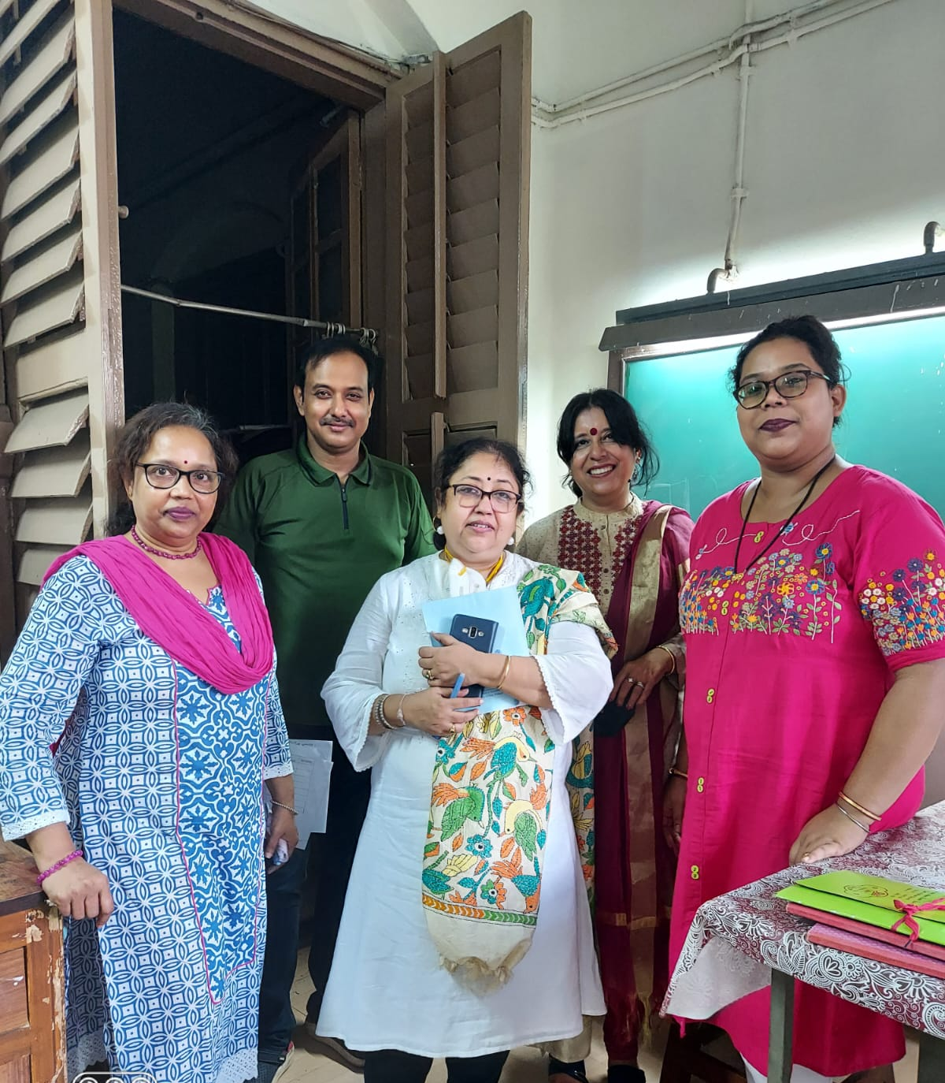
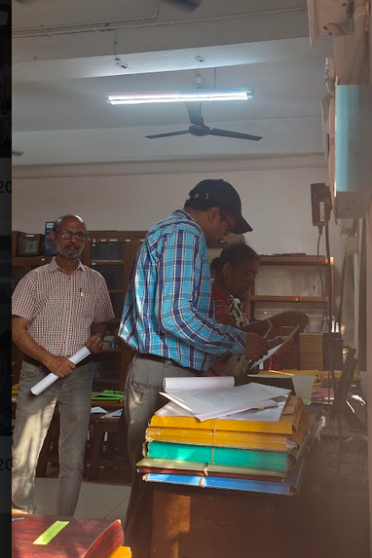
Academic Audit
Internal Audit at Psychology Department on 2nd March, 2023
Internal Audit at Political Science Department on 5th July, 2022

Slide 25
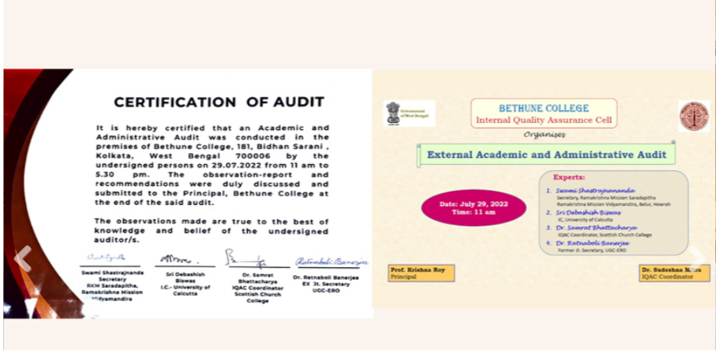
External Academic Audit

Slide 26
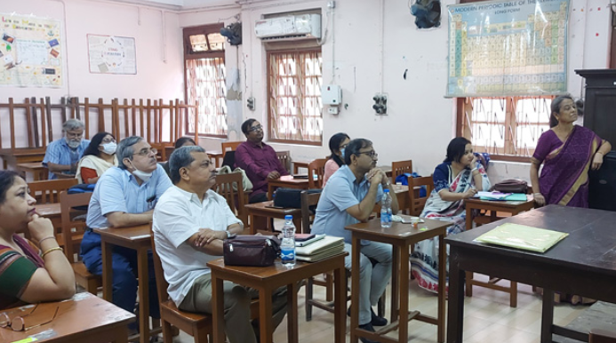
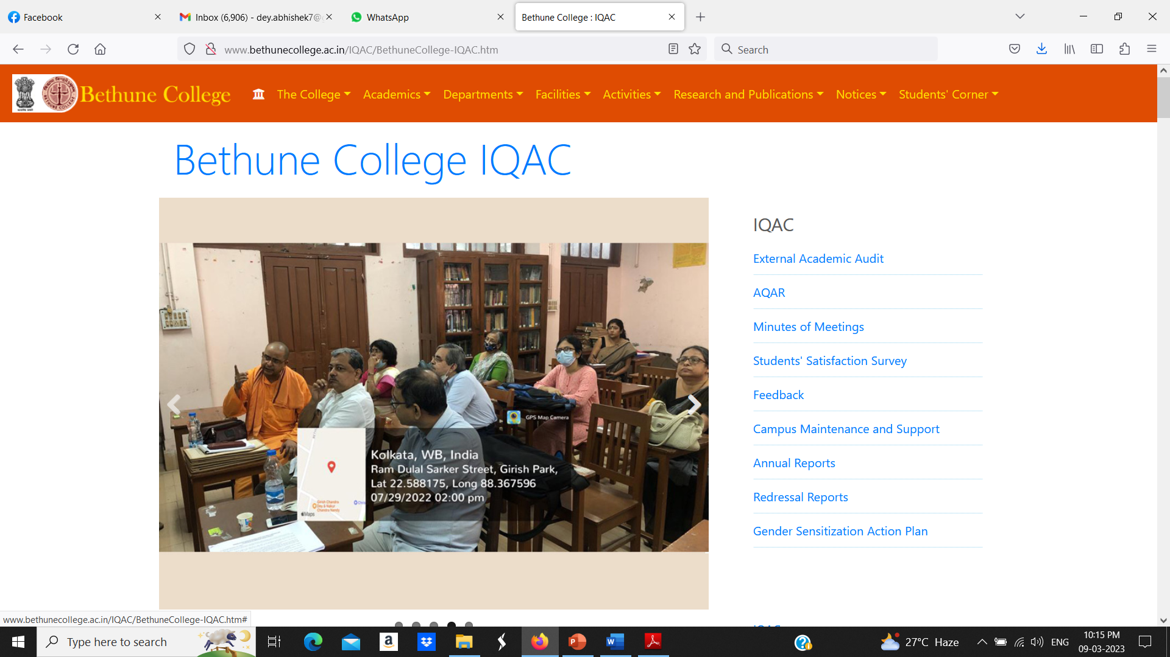
Academic Audit
External Academic Audit on 29th July, 2022
Members of the Expert Team:
1. Swami Shastrajnananda, Secretary, Ramakrishna Mission Saradapitha.
2. Sri Debashish Biswas. Inspector of Colleges, University of Calcutta
3. Dr. Samrat Bhattacharya, 1QAC Coordinator, Scottish Church College
4. Dr Ratnaboli Banerjee. Former Secretary, UGC, Eastern Region

Slide 27
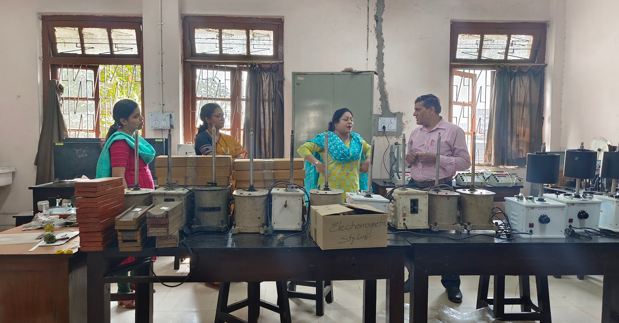
Laboratory Inspection
Laboratory Inspection at Psychology Department on 2nd March, 2023

Slide 28
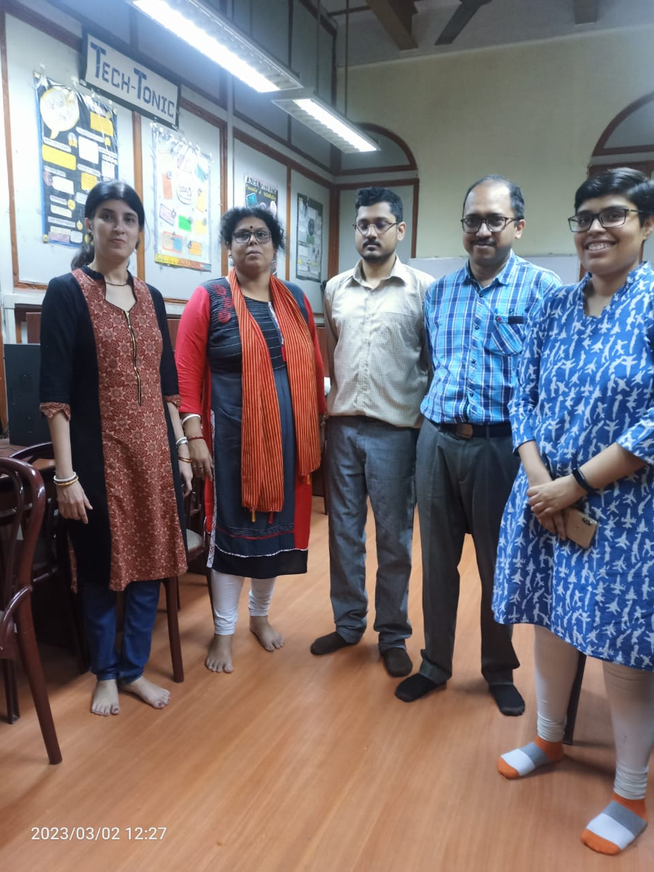
Laboratory Inspection
Laboratory Inspection at Computer Science Department on 2nd March, 2023

Slide 29
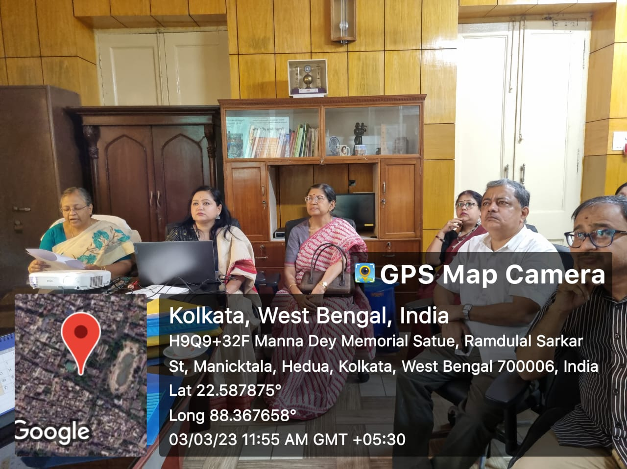
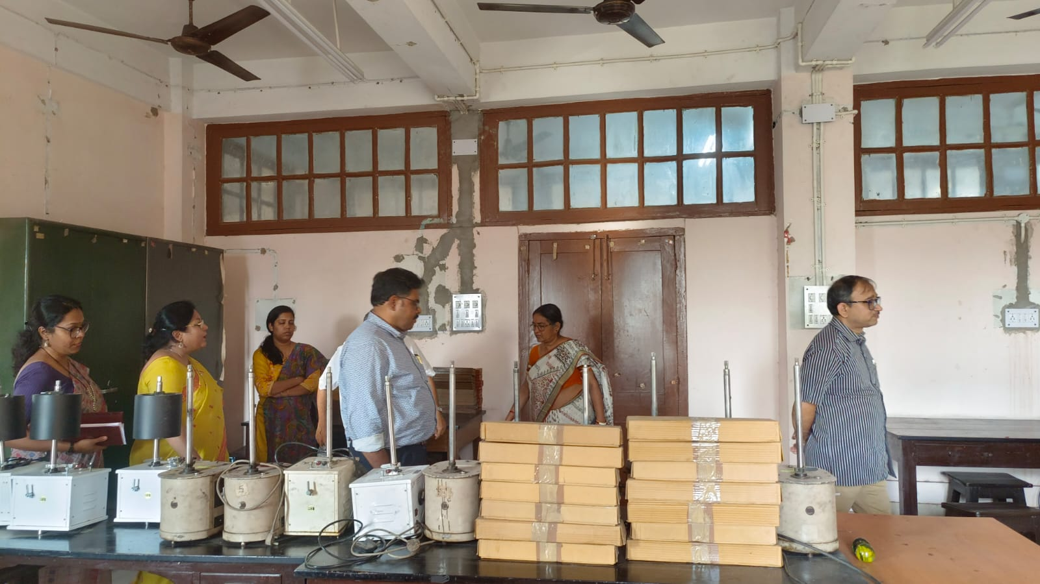
Mentoring Team Visit
Mentoring Team Visit on 3rd March, 2023

Slide 30
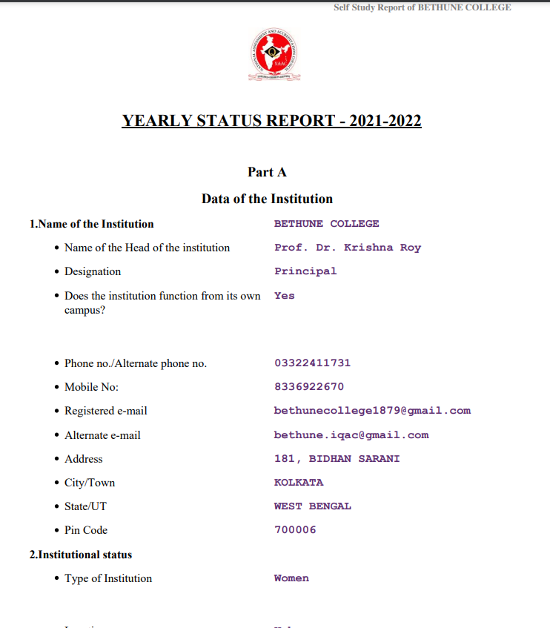
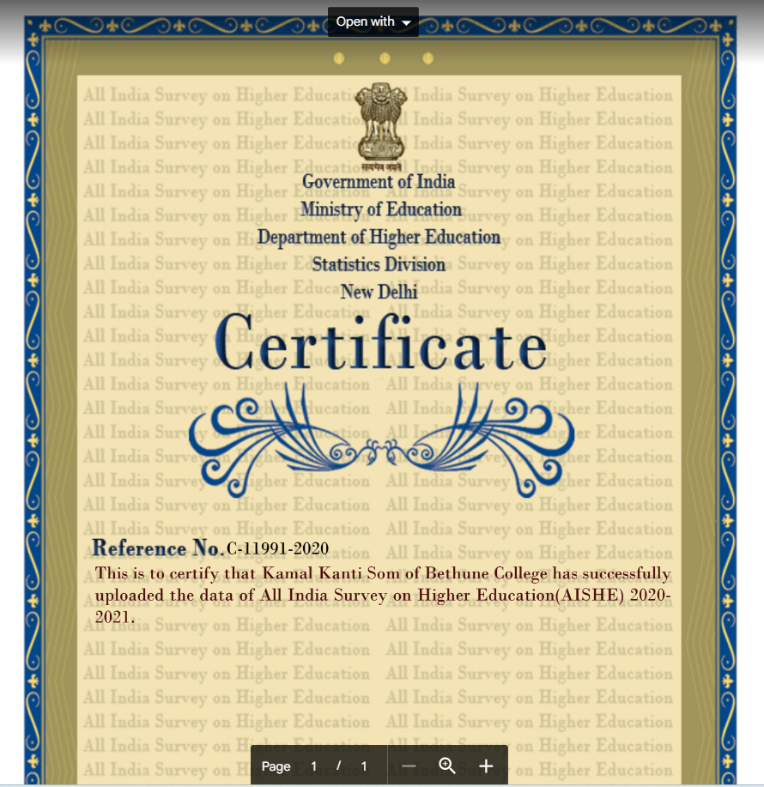
Submission of AISHE and AQAR

Slide 31
Report of Career Advancement of faculty members of Bethune College (2017 – 2020)
Year | Date | Stage | Number | Total
2017 | 09.01.2017 | III to IV I to II | 6 5 | 11
2018 | 18.04.2018 | III to IV II to III I to II | 3 1 2 | 6
2020 | 23.09.2020 | III to IV II to III I to II | 1 7 2 | 10

Slide 32
Report of Career Advancement of faculty members of Bethune College (2020 – 2023)
Year | Date | Stage | Number | Total
2021 | 02.02.2021 | III to IV II to III I to II | 1 3 3 | 7
 | 05.10.2021 | III to IV II to III I to II | 1 4 7 | 12
2022 | 07.05.2022 | I to II III to IV | 3 5 | 8
 | 11.06.2022 | II to III I to II | 3 2 | 5
 | 11.08.2022 | I to II II to III | 10 1 | 11
2023 | 06.03.2023 | II to III III to IV | 2 3 | 5
Total number of CAS during 2017-2023: 75

Slide 33
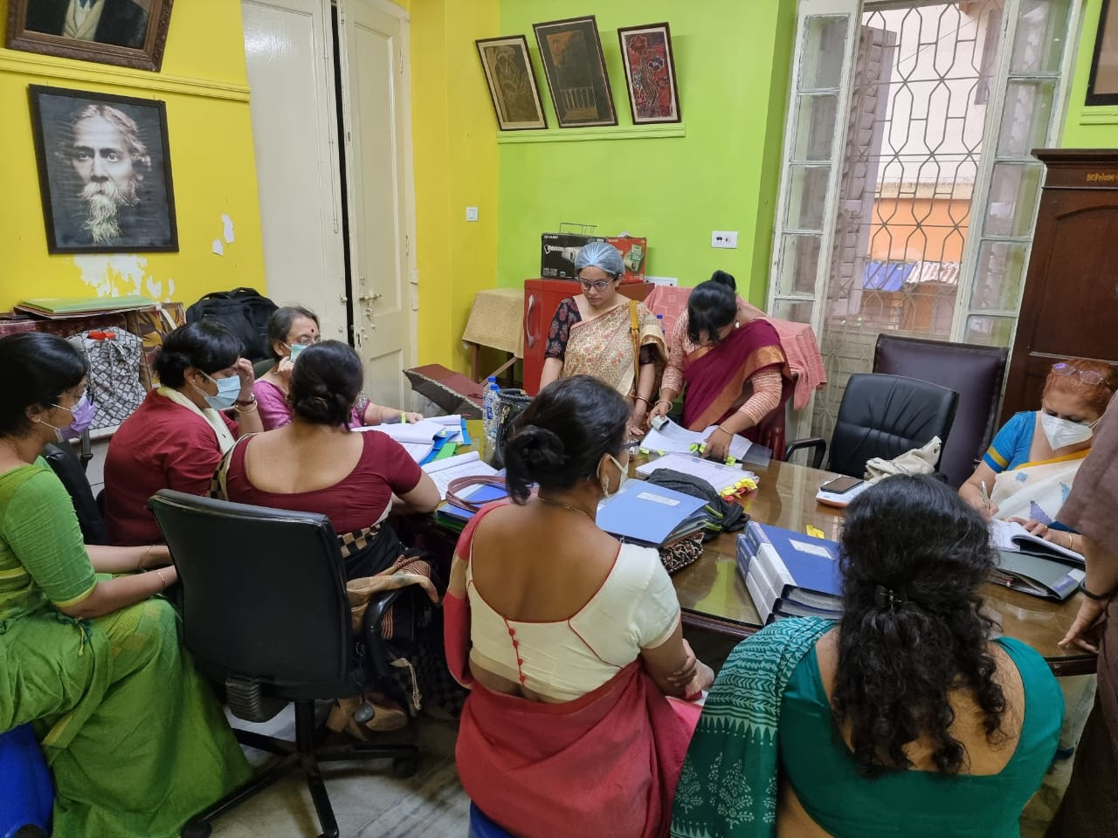
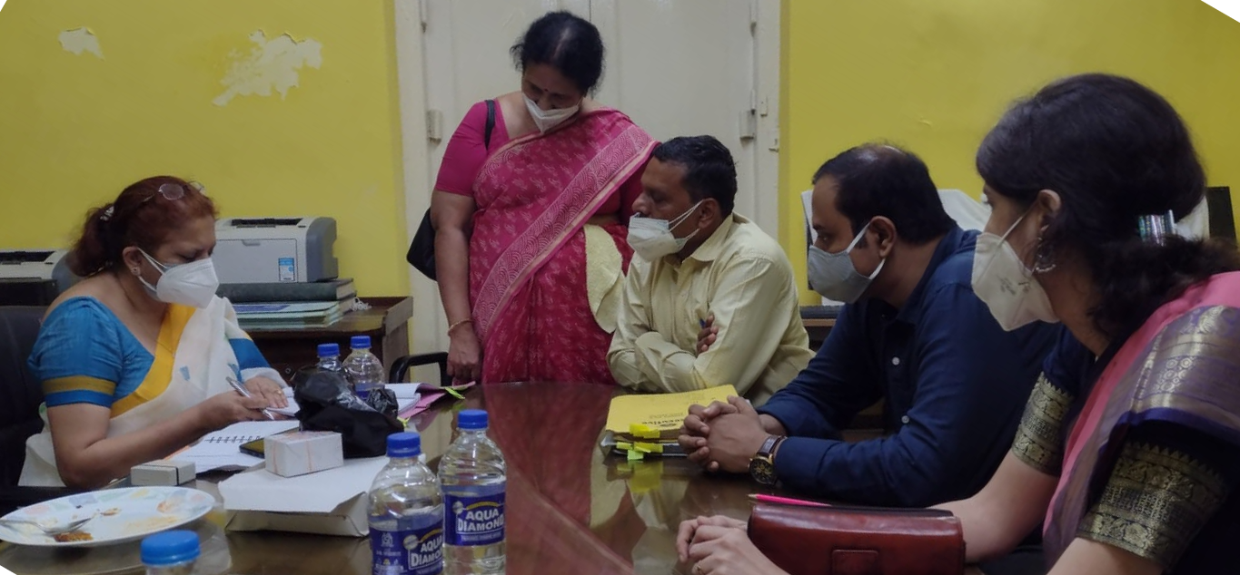
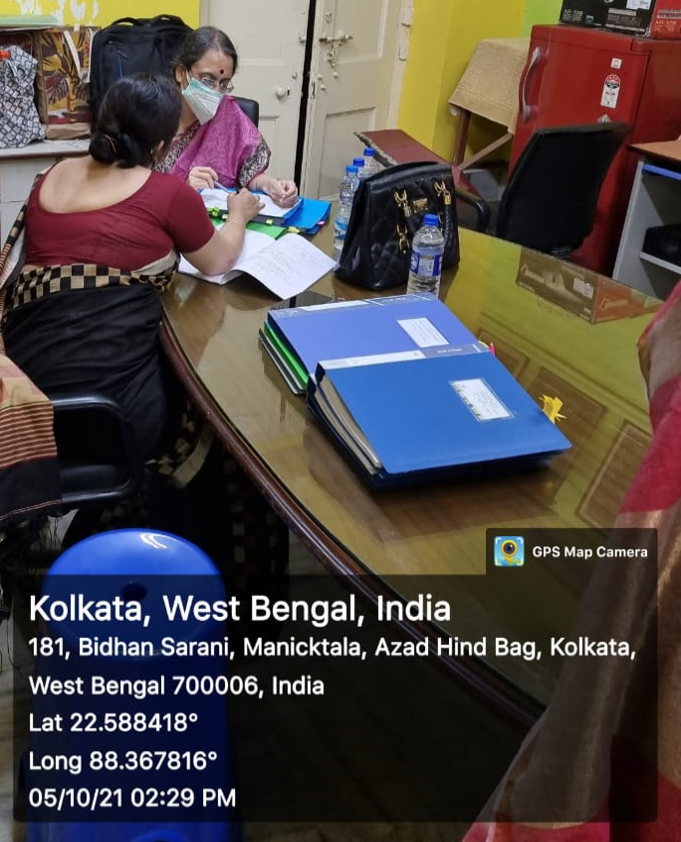
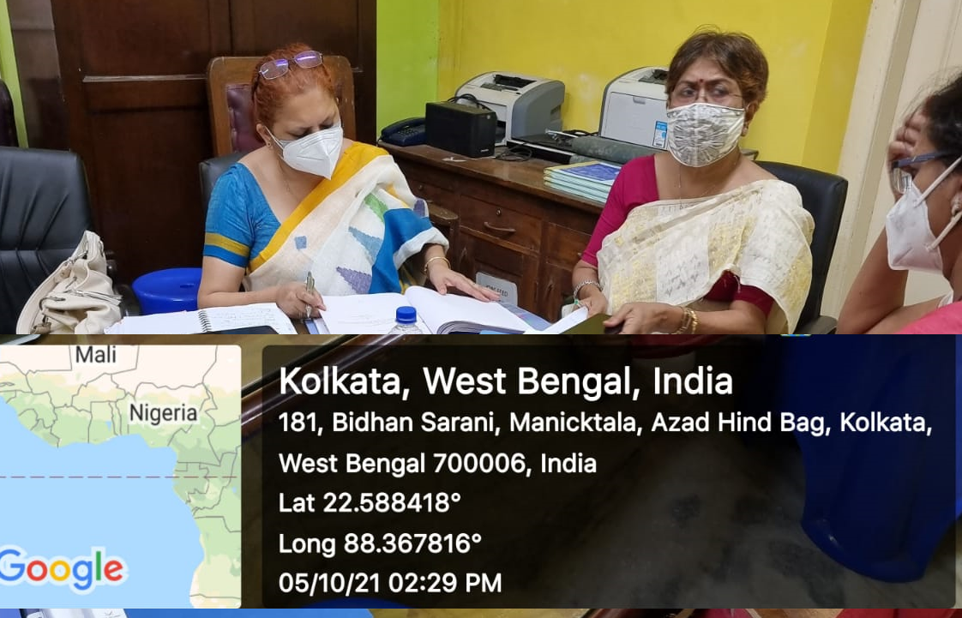
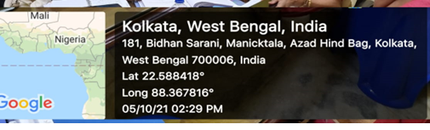
Some Glimpses of CAS procedure at Bethune College

Slide 34
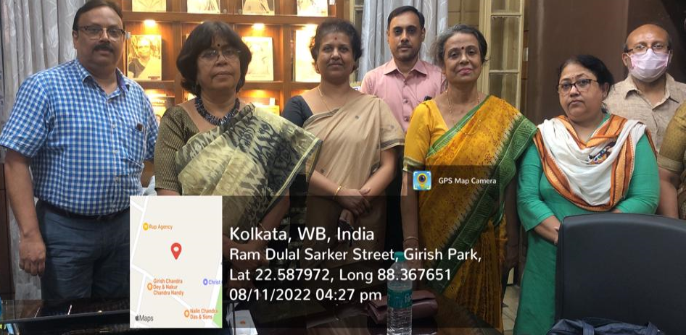
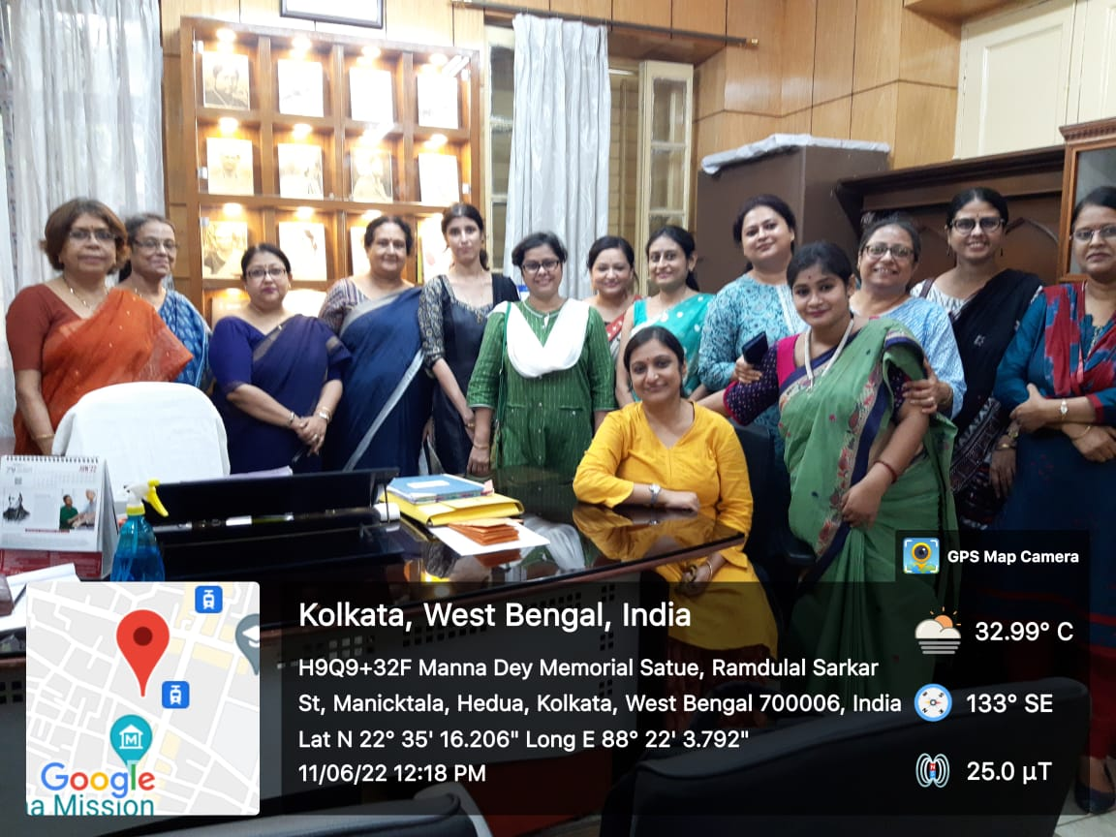
Some Glimpses of CAS procedure at Bethune College
DPI Nominee and Subject Experts with Principal, IQAC Coordinator and some Committee members during Career Advancement process
Incumbents with Principal, IQAC Coordintor and other faculty members of Bethune College

Slide 35
Highly Qualified Teachers Contributing towards Institutional Quality Assurance
Faculty Development Programmes
Online mode of teaching-learning using Skype, Zoom, Google meet
Sharing and uploading of course study materials through LMS
Research Projects and Publications
Resource Persons in seminars/ RC/OP

Slide 36

Support System To Students
Ethics and Value Education: Instilling Moral awareness
Student Hostel
Principal and Dedicated Teachers
C.U prescribed CBCS Curriculum and Internal Assessment
Library/ Book Bank/ Dept Library and Archive
Career / Academic/ Psychological Counselling
Student seminar/ Debate/ to encourage innovative thinking
NSS activity for the underprivileged: ensuring participation in social work
Grievance Redressal and Disciplinary cell
Anti Ragging cell
Annual Function & Fest: encouraging extra curricular activity & independent organizational capacity
Backward Class and Minority Cell
Intellectual Property Right Cell
Students’ Union
ICT and E-learning
Parent Teacher Meet
Students’Activity Cell
Student Satisfaction Survey
Internal Complaints Committee
Student Feedback
Sports Activity and Gymnasium
Student Aid Fund
Mentorship

Slide 37
Students’ Satisfaction Survey: few snapshots

Slide 38
Students’ Satisfaction Survey: few snapshots

Slide 39
Feedback from stakeholders
FEEDBACK
STUDENTS
ALUMNI
TEACHERS
PARENTS

Slide 40
Feedback on the academic performance and ambience of the institution from Students, Teachers and Alumni, conducted by IQAC

Slide 41



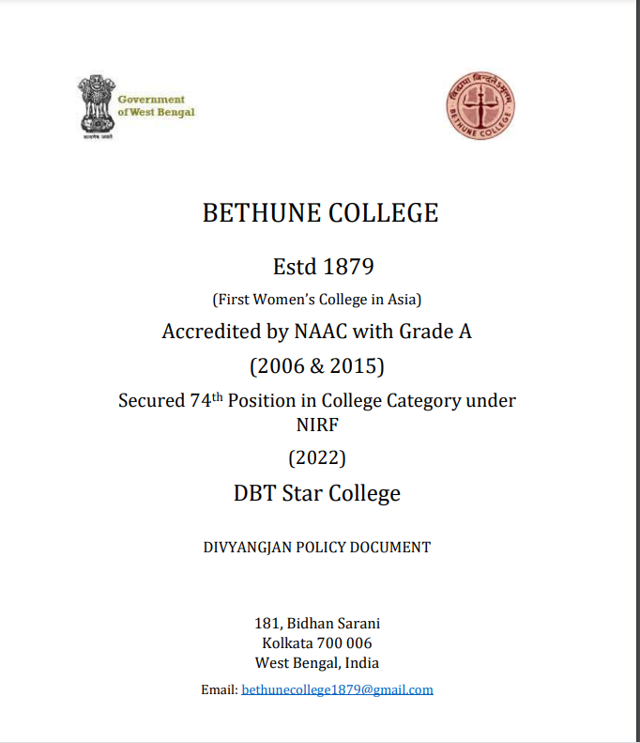
http://www.bethunecollege.ac.in/IQAC/greenCampus/7_1_2-Green-Campus-Policy.pdf http://www.bethunecollege.ac.in/IQAC/redressalReports/Grievance-Redressal-Policy-Document.pdf http://www.bethunecollege.ac.in/IQAC/genderSensitization/Annual-Gender-Sensitization-ActionPlan-2022-23.pdf http://www.bethunecollege.ac.in/IQAC/divyangjan/7_1_2-Divyangjan-Policy.pdf
Framing Policy Documents

Slide 42
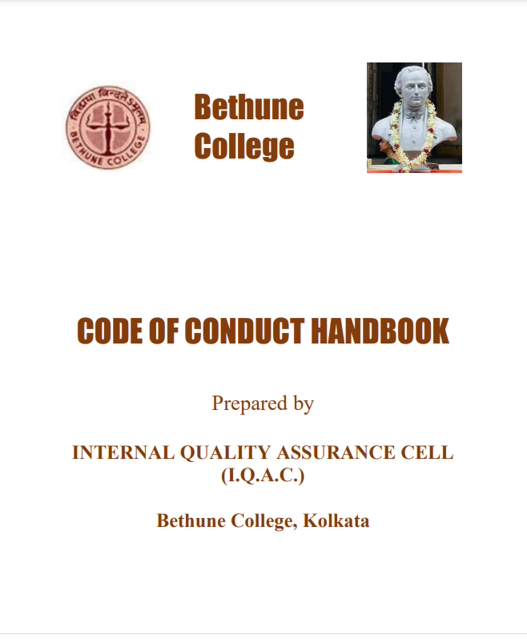
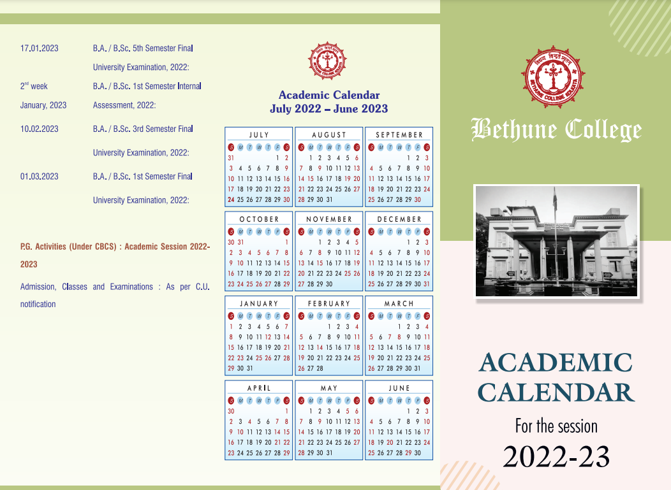
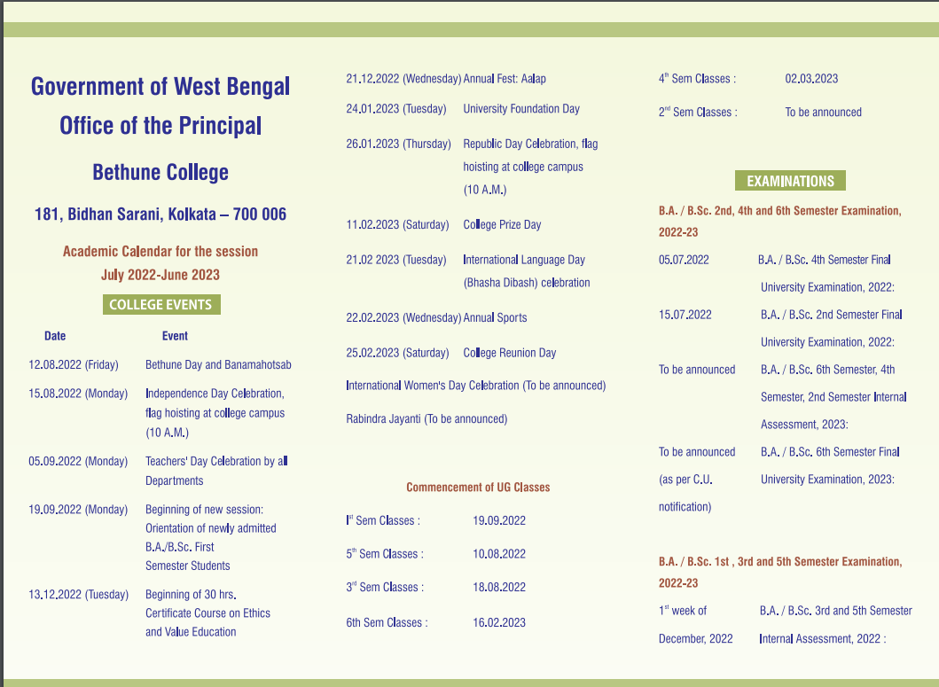
Preparation of Code of Conduct Handbooks and Academic Calendars

Slide 43
NIRF Ranking
IQAC took initiative to participate in NIRF rankings for the first time in 2019
Bethune College is the first Govt. Women College from West Bengal in NIRF rankings under college category
Year | Rank
2022 | 74
2021 | 77
2020 | 88
2019 | 50

Slide 44
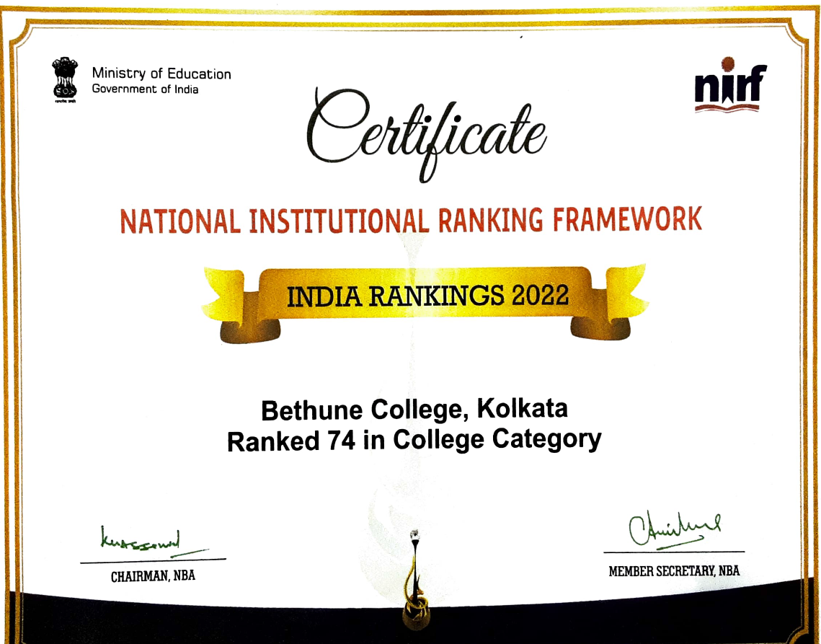
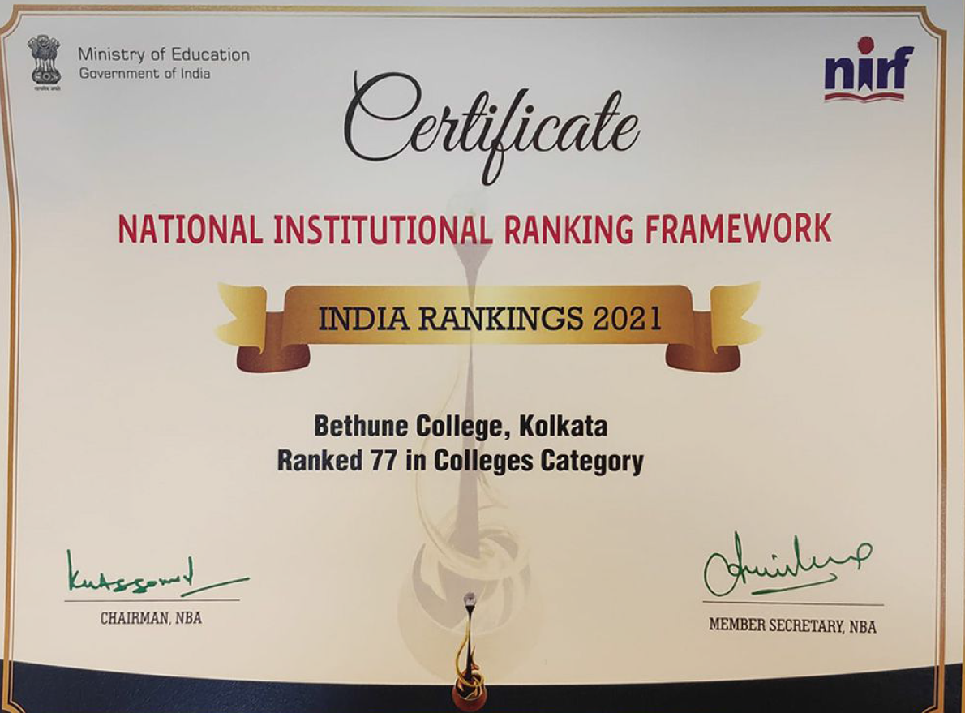
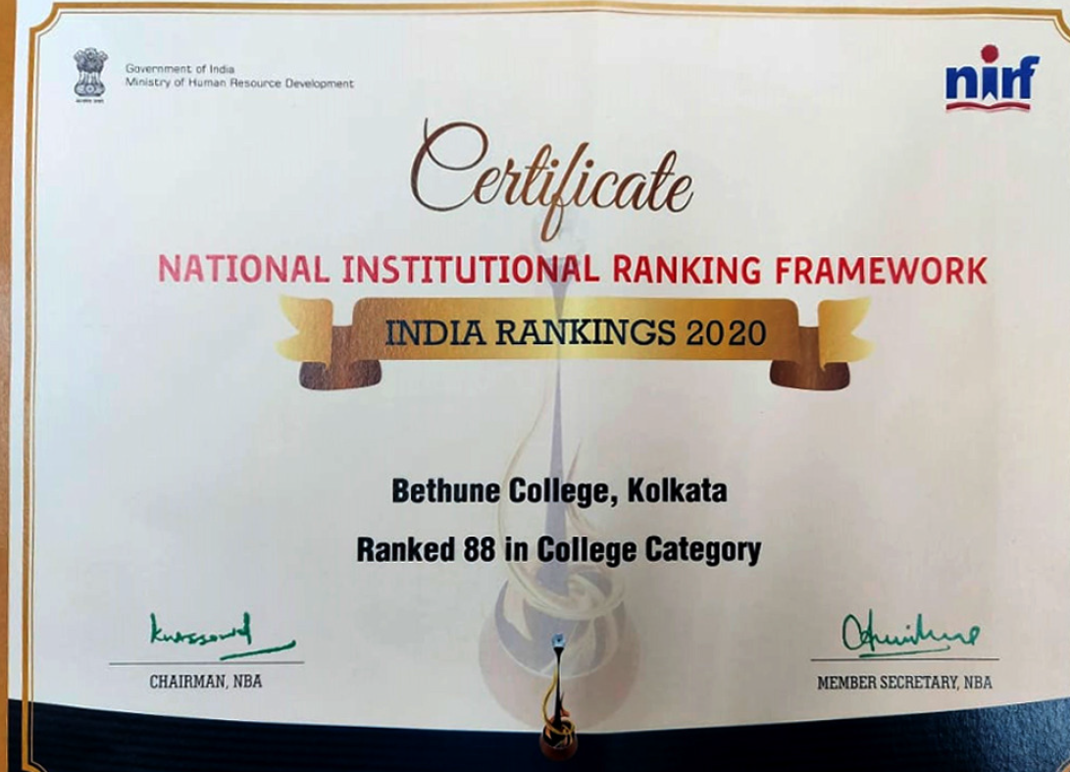
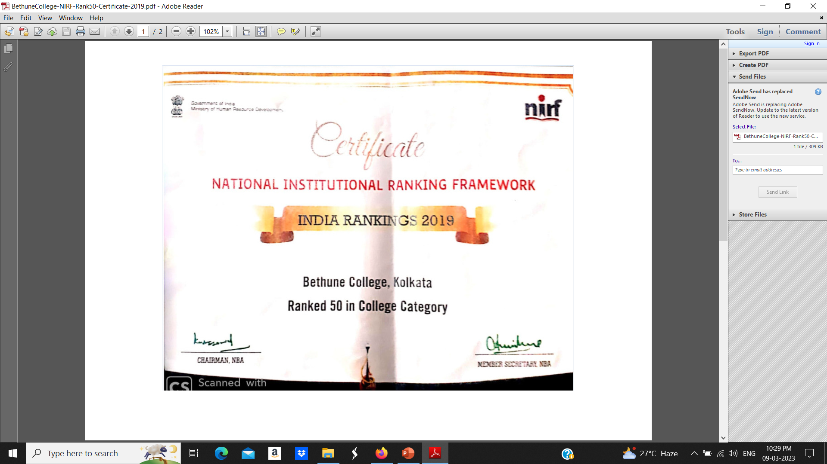
NIRF Ranking

Slide 45
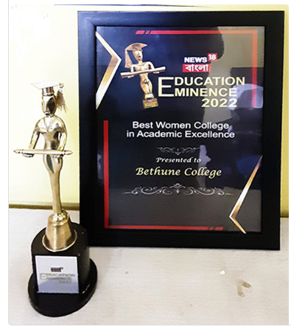

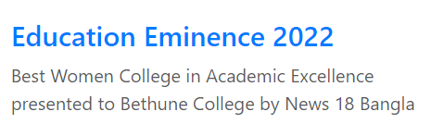

Some of the many Awards

Slide 46
Thank You

